Slide 1
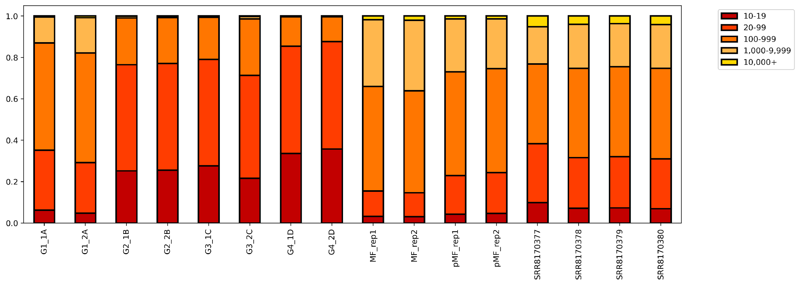
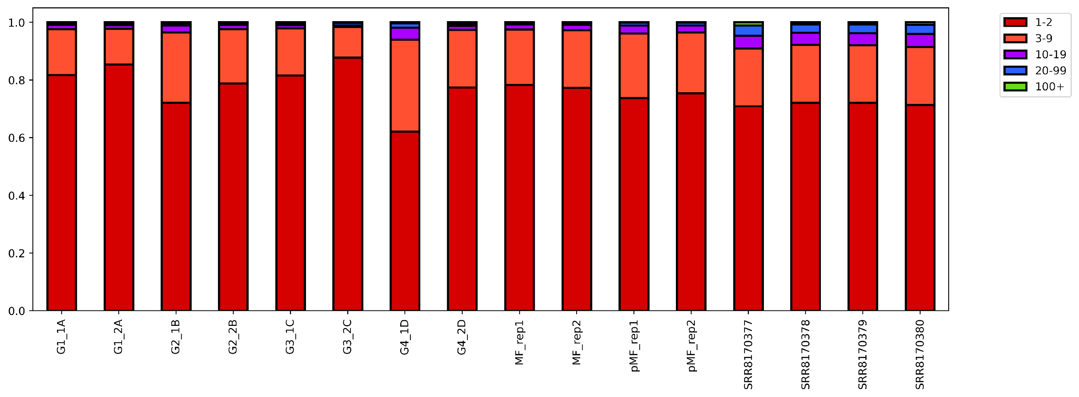
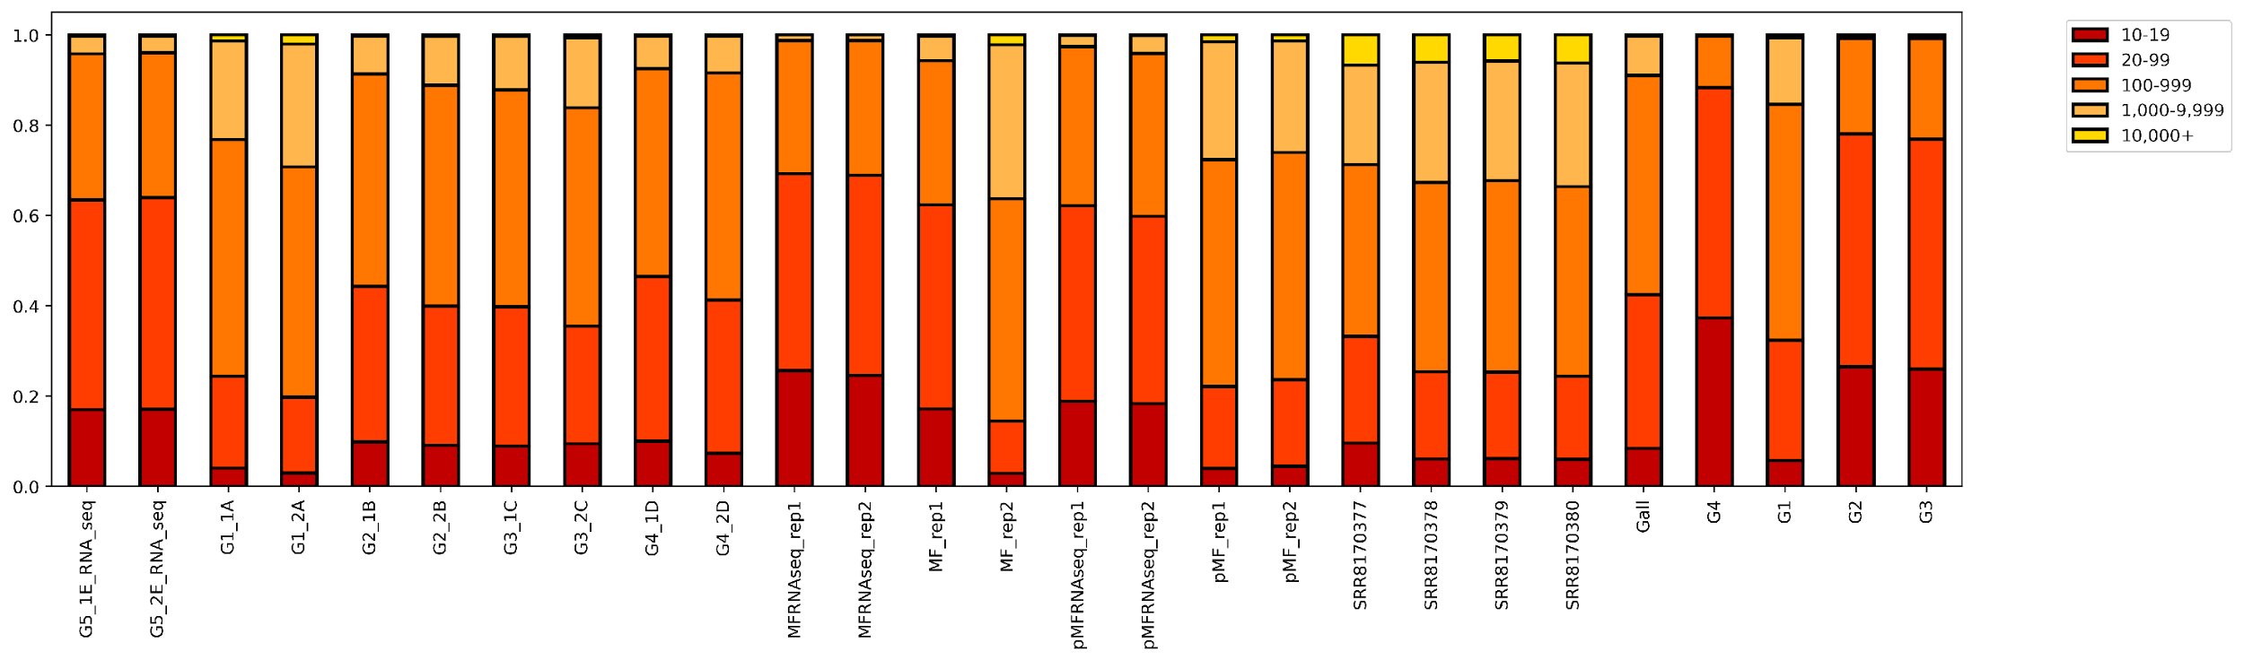
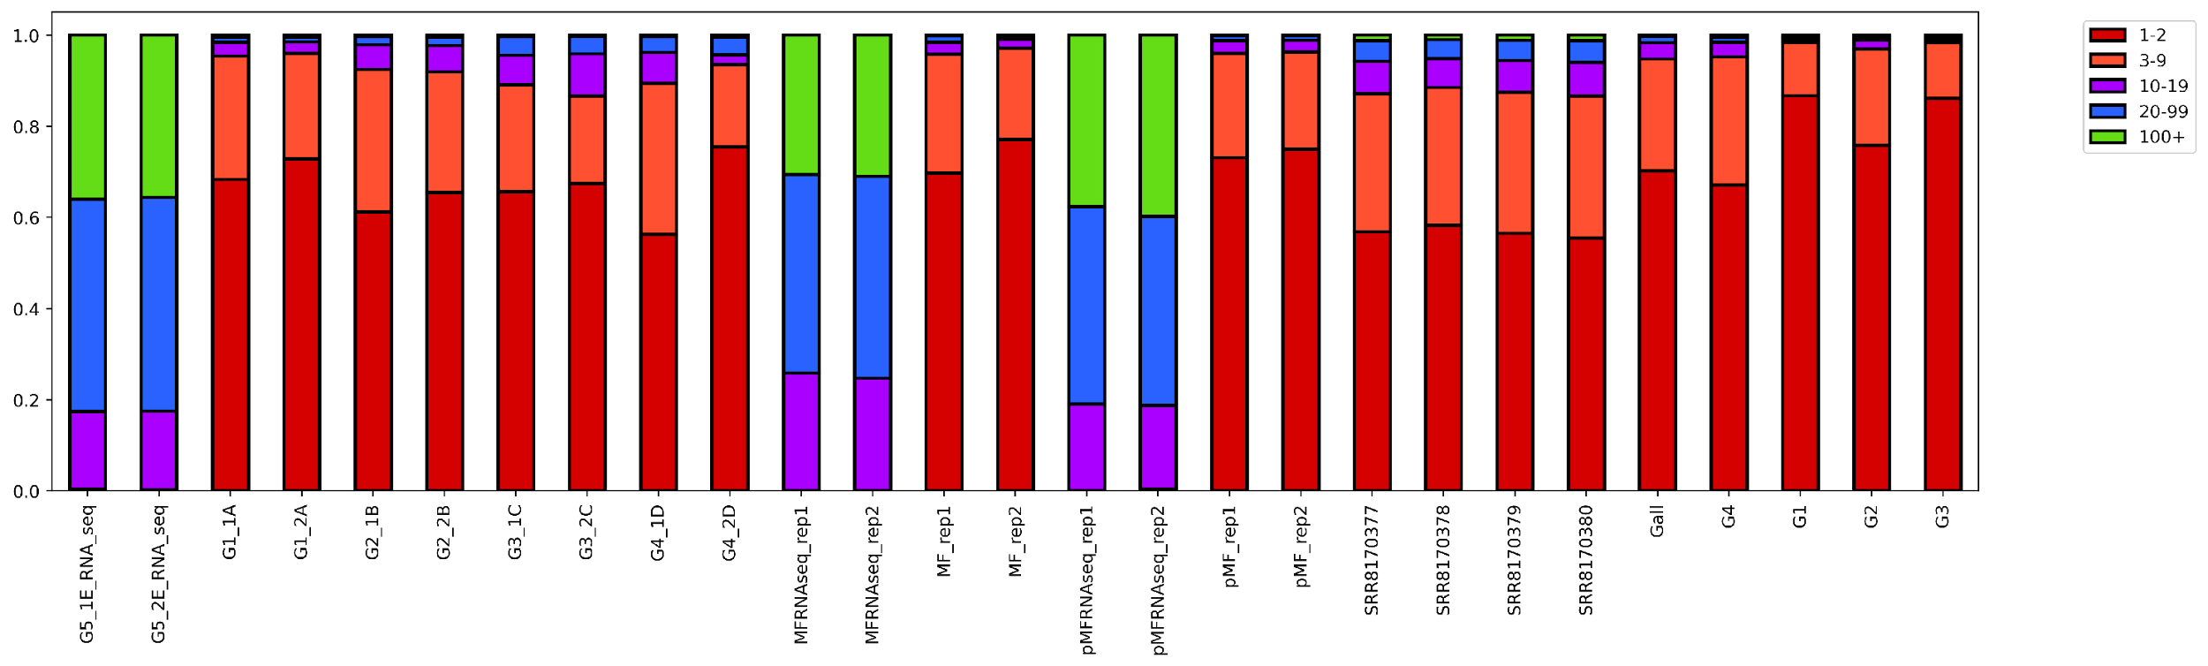
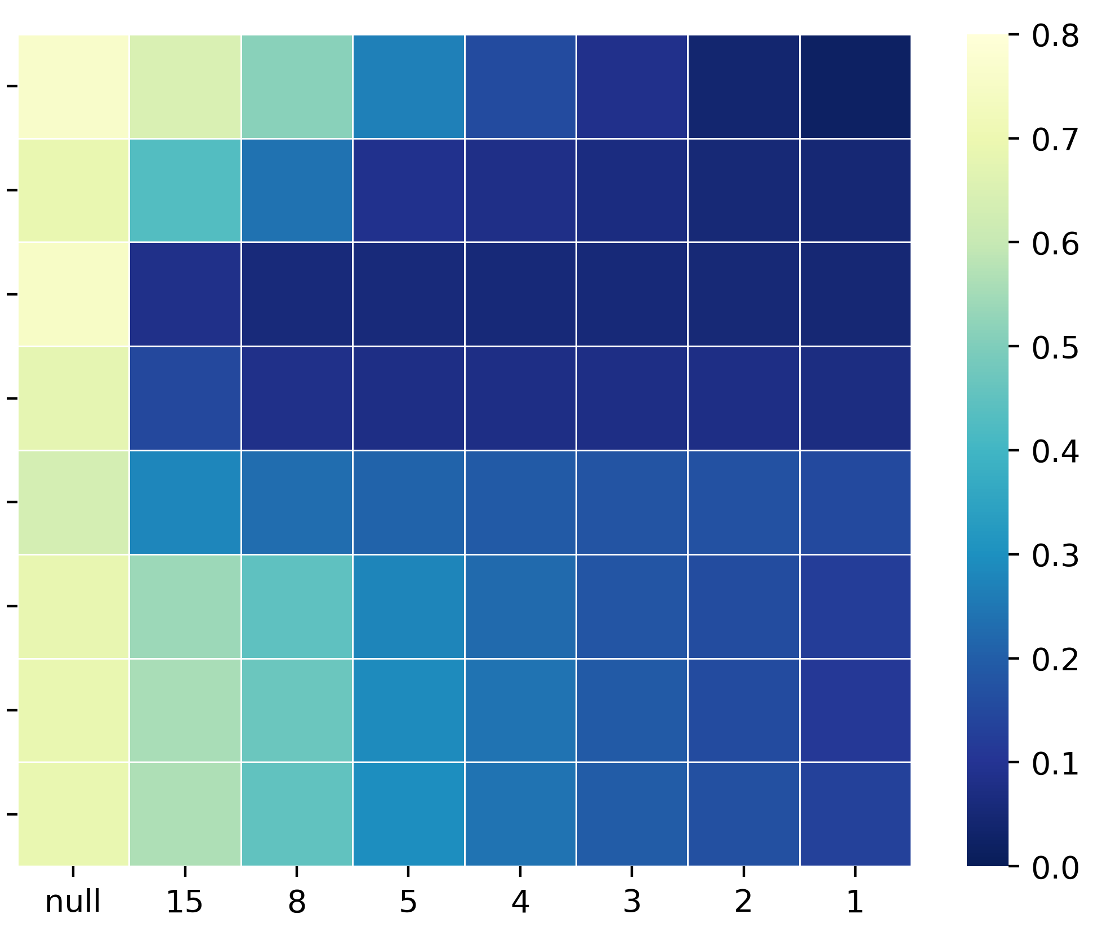
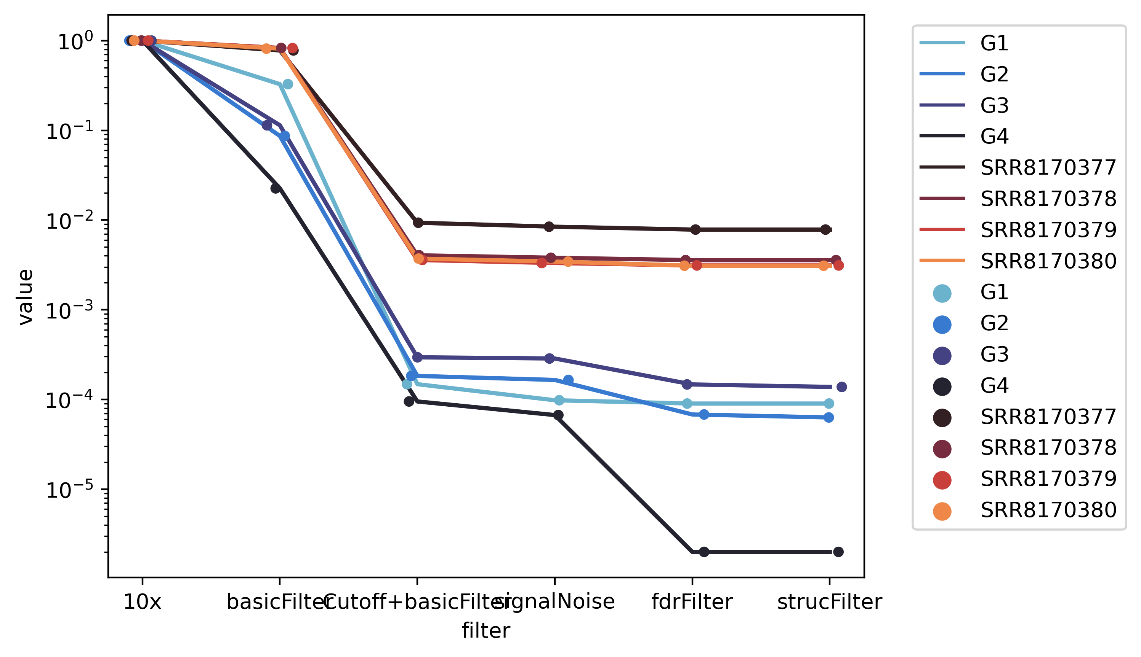
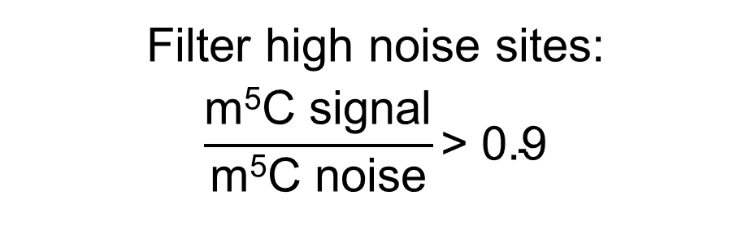
A
C-cutoff of reads as determined by Gini Coefficient
Filter sites predicted to be conversion resistant (RNAfold)
Require 10x (C+T) coverage at p-m⁵C sites
≥ 20x (C+T) coverage,
≥ 3 m⁵C, ≥ 0.1 m⁵C level
Final
sites
Filter high noise sites:
$$\frac{\text{m}\text{5}\text{C} \text{signal}}{\text{m}\text{5}\text{C} \text{noise}}\text{> 0.9}$$
Filter sites by adjusted p-value
(FDR ≤ 0.05)
B
C
1.0
0.8
0.6
0.4
0.2
0
Coverage at p-m⁵C site
1.0
0.8
0.6
0.4
0.2
0
Number of p-m⁵C per site
10-19
20-99
100-999
1,000-9,999
10,000+
1-2
3-9
10-19
20-99
100+
Proportion of reads
Proportion of reads
Mitochondrial RNA
Huang
Mitochondrial RNA
Huang
D
MT-A
MT-B
MT-C
MT-D
MT-A
MT-B
MT-C
MT-D
Gini
E
MT-A
MT-B
MT-C
MT-D
Huang 1
Huang 2
Huang 3
Huang 4
Proportion of remaining sites
MT-A
MT-B
MT-C
MT-D
Huang 1
Huang 2
Huang 3
Huang 4
C-cutoff
10x (C+T) | Standard filter | C-cutoff + standard filter | Signal/ Noise | FDR filter | Structure filter
Figure 4. Effects of m⁵C filtering steps on bisulfite sequencing data analysis. (A) The summarized m⁵C filtering pipeline after methylation calling. Methylation sites were called using meRanCall. (B) Binned (C+T) coverage values of m⁵C sites in each bisulfite sequencing library. Mitochondrial replicates were merged into single libraries for m⁵C calling purposes (C) Binned p-m⁵C coverage per site identified. (D) Gini coefficient was measured after iterative C-cutoffs were performed for each library. A C-cutoff describes the criteria for retaining reads with multiple p-m⁵C sites. The Gini coefficients of all bisulfite converted libraries are displayed as a heatmap. (E) The proportion of remaining p-m⁵C sites after each step of p-m⁵C filtering for bisulfite sequencing libraries. The original reported sites are determined using meRanCall with a 10x (C+T) coverage filter. Blue lines represent mitochondrial libraries, purple lines represent Total and Polysome libraries, red-orange lines represent external datasets used.

